Slide 1
Structured Organization
A structured organizational structure is characterized by clear lines of authority, well-defined roles and responsibilities, and a formalized hierarchy
Characteristics:
Clear hierarchy with levels of management.
Well-defined roles and responsibilities for each position.
Formal communication channels.
Decisions flow through the established hierarchy.
Common in large, established organizations.

Slide 2
Structured Organization
Advantages:
Clearly defined roles help in efficient task allocation.
Formal communication channels facilitate order and control.
Well-suited for stable and routine tasks.
Disadvantages:
May lead to bureaucracy and slow decision-making.
Less adaptable to change.
Limited employee empowerment

Slide 3
Unstructured Organization
An unstructured organizational structure is characterized by flexibility, fluidity, and a lack of rigid hierarchy. It is often associated with smaller organizations, startups, or those emphasizing innovation and creativity.
Characteristics:
Flexible roles and responsibilities.
Informal communication channels and networks.
Emphasis on collaboration and teamwork.
Decentralized decision-making.
Common in dynamic and creative industries.

Slide 4
Unstructured Organization
Advantages:
Promotes innovation and adaptability.
Encourages employee creativity and empowerment.
Responsive to changes in the external environment.
Disadvantages:
Lack of clear structure may lead to confusion.
Challenges in maintaining consistency.
Decision-making may become decentralized to the point of inefficiency.

Slide 5
Organizational Structures Influence on Projects
The organizational structure of a company has a significant impact on how projects are planned, executed, and controlled.
Different organizational structures provide unique environments and communication channels that can influence the success of a project.
Communication Channels:
Functional Structure: In a functional organization, communication tends to flow vertically through functional departments. Project team members report to functional managers, and information may take longer to reach stakeholders outside a specific department.
Matrix Structure: In a matrix organization, there are dual reporting relationships—functional and project. This can improve communication, as team members have direct access to both functional and project managers.

Slide 6
Organizational Structures Influence on Projects
Authority and Decision-Making:
Functional Structure: Project managers in functional organizations often have limited authority and must rely on functional managers for resources and decision-making. This can result in slower decision-making processes.
Matrix Structure: Project managers in a matrix organization have more authority over project resources, which can lead to quicker decision-making. However, conflicts may arise over resource allocation between functional and project managers.
Resource Allocation:
Functional Structure: Resources are controlled by functional managers, and project managers must negotiate for the allocation of resources. This can lead to challenges in resource availability and allocation across projects.
Matrix Structure: Project managers have more control over resources, but they may still need to negotiate with functional managers. There may be a need for clear guidelines on resource priorities and allocation.

Slide 7
Organizational Structures Influence on Projects
Flexibility and Adaptability:
Functional Structure: Functional organizations may be less flexible, as resources are dedicated to functional areas and may be less available for projects. Changes in project scope may be challenging to accommodate.
Matrix Structure: Matrix organizations are often more adaptable, with resources available for projects. The matrix structure allows for better responsiveness to changes in project requirements.
Project Team Loyalty:
Functional Structure: Team members in a functional organization may prioritize loyalty to their functional departments over project goals. This can affect team cohesion and commitment to project objectives.
Matrix Structure: Matrix organizations can foster a sense of team loyalty to both the functional department and the project. However, conflicts may arise if priorities conflict.

Slide 8
Organizational Structures Influence on Projects
Project Manager's Role:
Functional Structure: Project managers in functional organizations may have a part-time role with limited authority. They focus on project coordination but rely heavily on functional managers for support.
Matrix Structure: Project managers in a matrix organization have a more central role, with greater responsibility and authority. They are accountable for project success and have a direct impact on project outcomes.
Organizational Culture:
The overall culture of the organization, whether it encourages innovation, collaboration, and risk-taking, can influence project success. A culture that supports project management practices is more likely to foster successful project outcomes.

Slide 9
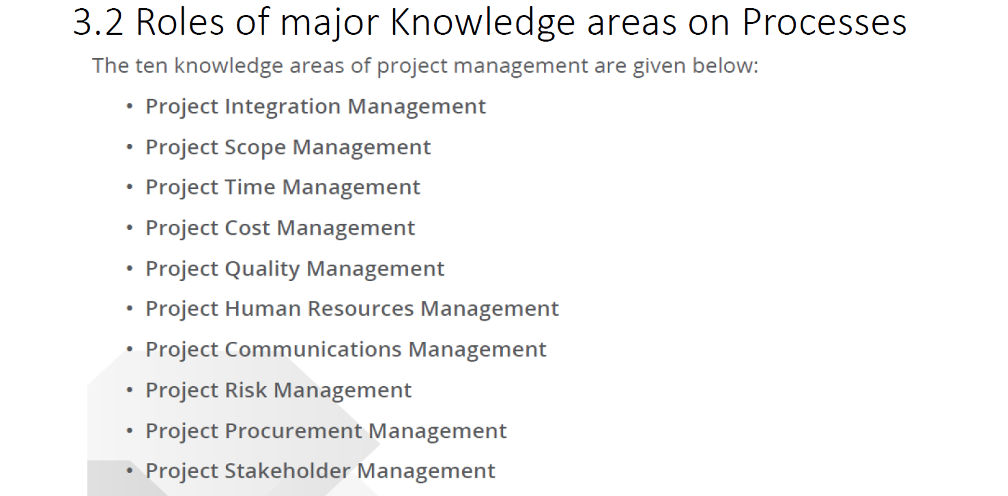

Slide 10
Integration Management:
Ensures that all project components are coordinated effectively.
It involves developing a project charter, project management plan, project execution, monitoring and controlling, and project closing.
Scope Management
Defines and controls what is and is not included in the project.
It involves planning, defining, creating a work breakdown structure (WBS), validating scope, and controlling changes to the project scope.
Time Management
Ensures timely completion of the project.
It involves defining activities, sequencing them, estimating resource requirements, developing schedules, and controlling the schedule
Cost Management
Involves planning, estimating, budgeting, financing, funding, managing, and controlling costs to complete the project within the approved budget.
Quality Management
Ensures that the project will satisfy the needs for which it was undertaken.
It involves planning quality, performing quality assurance, and performing quality control.

Slide 11
Human Resource Management
Involves organizing and managing the project team.
It includes processes such as developing the project team, acquiring the project team, and managing the project team
Communications Management
Involves ensuring timely and appropriate planning, collection, creation, distribution, storage, retrieval, management, control, monitoring, and the ultimate disposition of project information.
Risk Management
Identifies, analyzes, and responds to project risks.
It includes risk management planning, risk identification, qualitative and quantitative risk analysis, risk response planning, and risk monitoring and control.
Procurement Management
Involves acquiring goods and services from outside the performing organization.
It includes processes such as planning procurement, conducting procurement, controlling procurement, and closing procurement.
Stakeholder Management
Involves identifying, analyzing, and managing relationships with project stakeholders.
It includes processes such as identifying stakeholders, planning stakeholder engagement, managing stakeholder engagement, and monitoring stakeholder engagement.

Slide 12
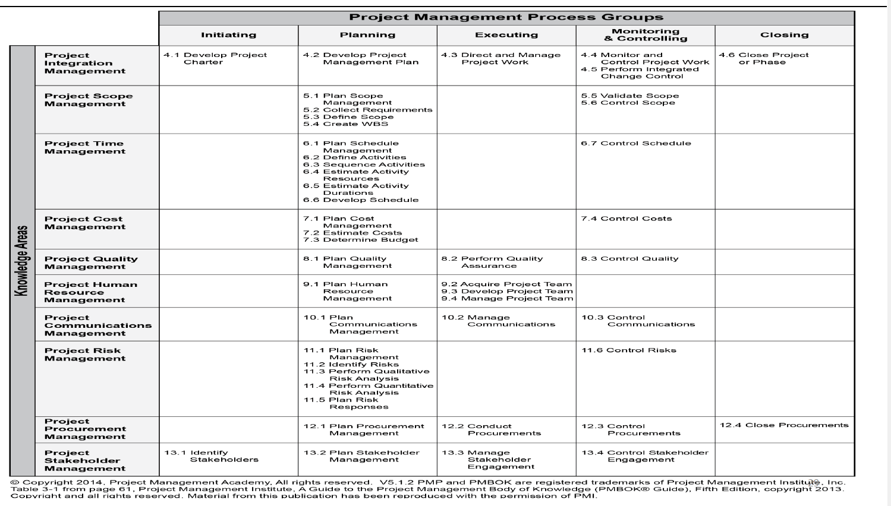

Slide 13
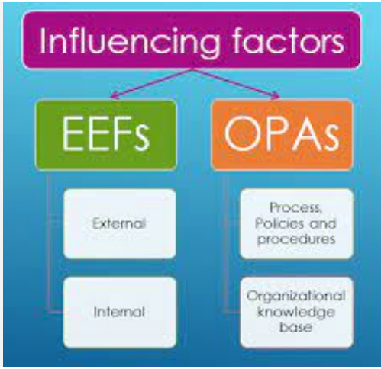

Slide 14
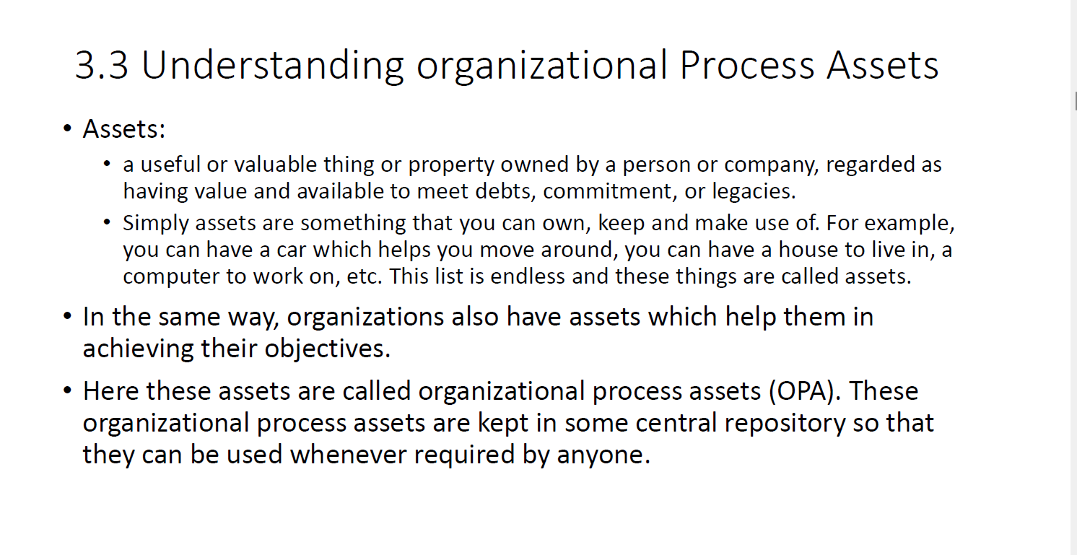

Slide 15
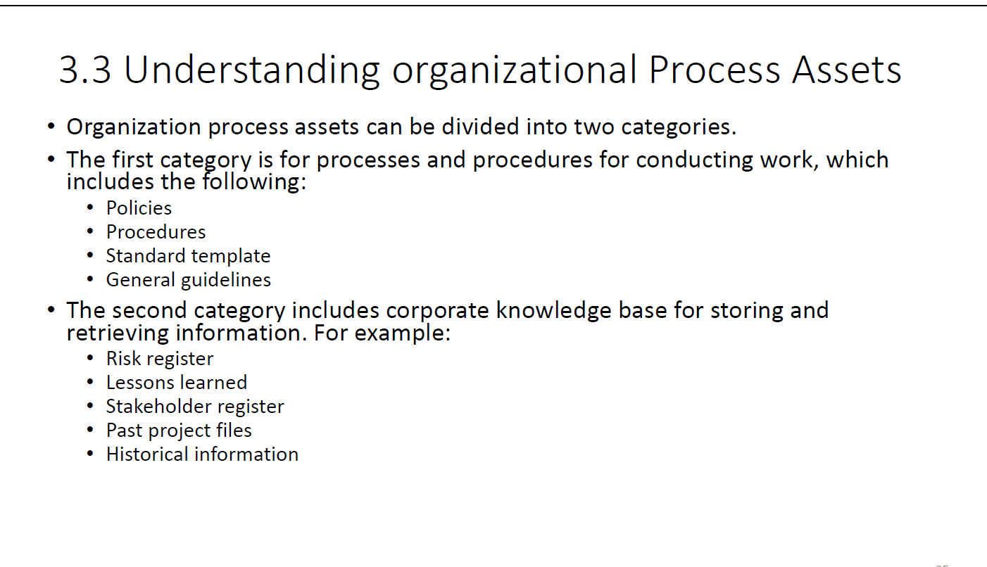

Slide 16
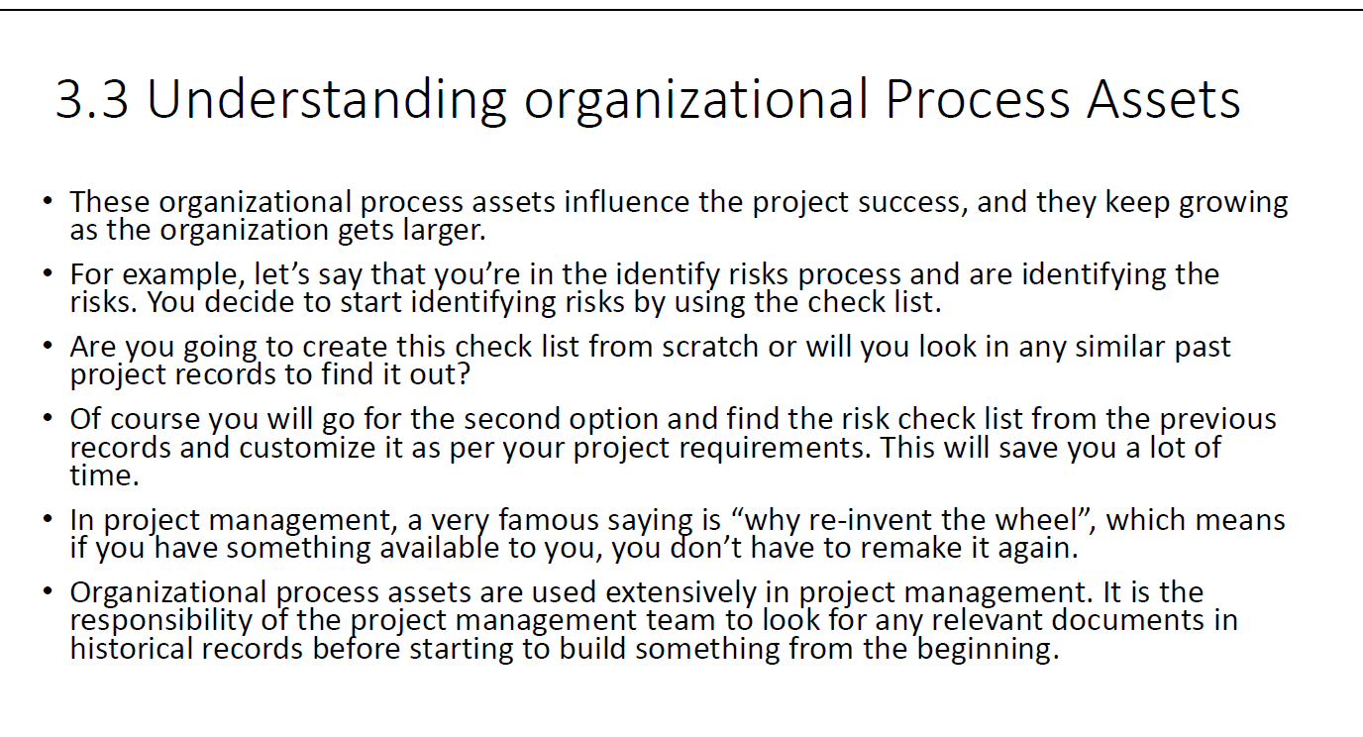

Slide 17
OPA
Organizational Process Assets (OPAs) refer to the plans, processes, policies, procedures, and knowledge bases that are specific to and used by an organization.
They influence the management of projects and can include both tangible and intangible assets.
Here are the types of Organizational Process Assets along with examples:
Processes and Procedures:
Examples: Standard operating procedures (SOPs), project management methodologies, and guidelines for project initiation, planning, execution, monitoring, and closing.
Templates and Forms:
Examples: Standardized templates for project management plans, risk registers, issue logs, change control forms, and other project-related documents.
Corporate Knowledge Base:
Examples: Lessons learned from previous projects, historical information on project performance, and best practices derived from successful projects.
Historical Information:
Examples: Records of past project performance, including project schedules, budgets, and outcomes. Documentation of issues faced and how they were resolved.

Slide 18
OPA
Best Practices:
Examples: Proven methods and approaches that have consistently led to successful project outcomes. These can include effective communication strategies, risk management techniques, and quality control practices.
Policies and Procedures:
Examples: Organizational policies related to project management, ethical guidelines, quality standards, safety protocols, and compliance requirements.
Organizational Structure and Culture:
Examples: The structure of the organization, reporting relationships, and the prevailing organizational culture, which can influence how projects are initiated, managed, and executed.
Governance Framework:
Examples: Governance frameworks that define how decisions are made, how project performance is monitored, and the authority levels for various project stakeholders.
Resource Availability:
Examples: Information about the availability and skill sets of resources within the organization, including human resources, equipment, and facilities.

Slide 19
OPA
Enterprise Environmental Factors (EEFs):
Examples: External factors that influence the organization, such as industry standards, market conditions, regulatory requirements, and technological advancements.
Change Control Procedures:
Examples: Processes for requesting, reviewing, approving, and implementing changes to the project, including change control boards and change request forms.
Communication Channels:
Examples: Information about established communication channels within the organization, including formal and informal communication methods and reporting structures.
Risk Databases:
Examples: Databases containing information on identified risks, risk assessments, and risk response strategies from past projects.
Lessons Learned Repository:
Examples: A repository containing documented lessons learned from completed projects, outlining what worked well and what could be improved in future projects.
Issue and Defect Management Database:
Examples: Records of issues and defects identified during project execution, along with their resolutions and the impact on project outcomes.

Slide 20
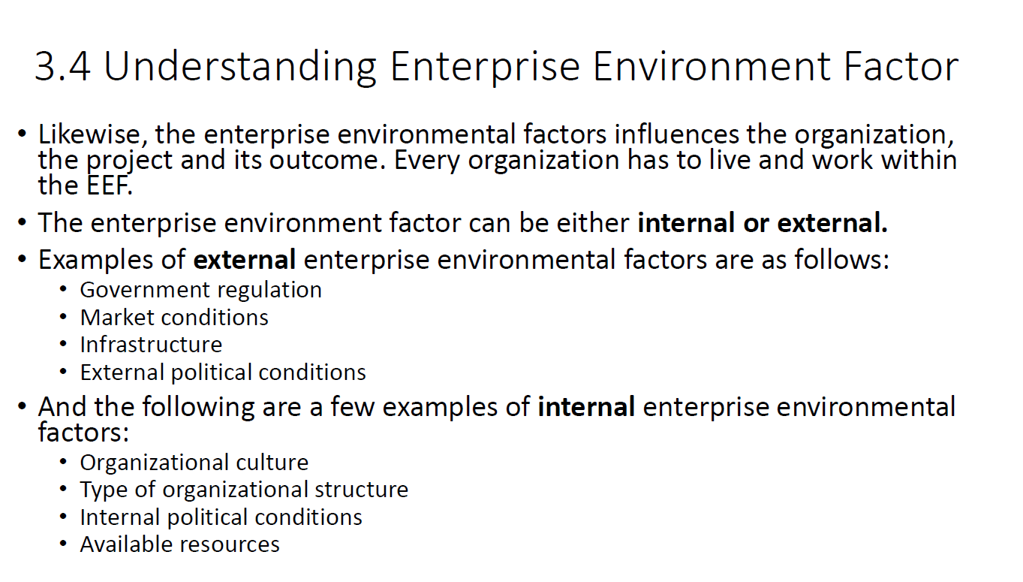

Slide 21
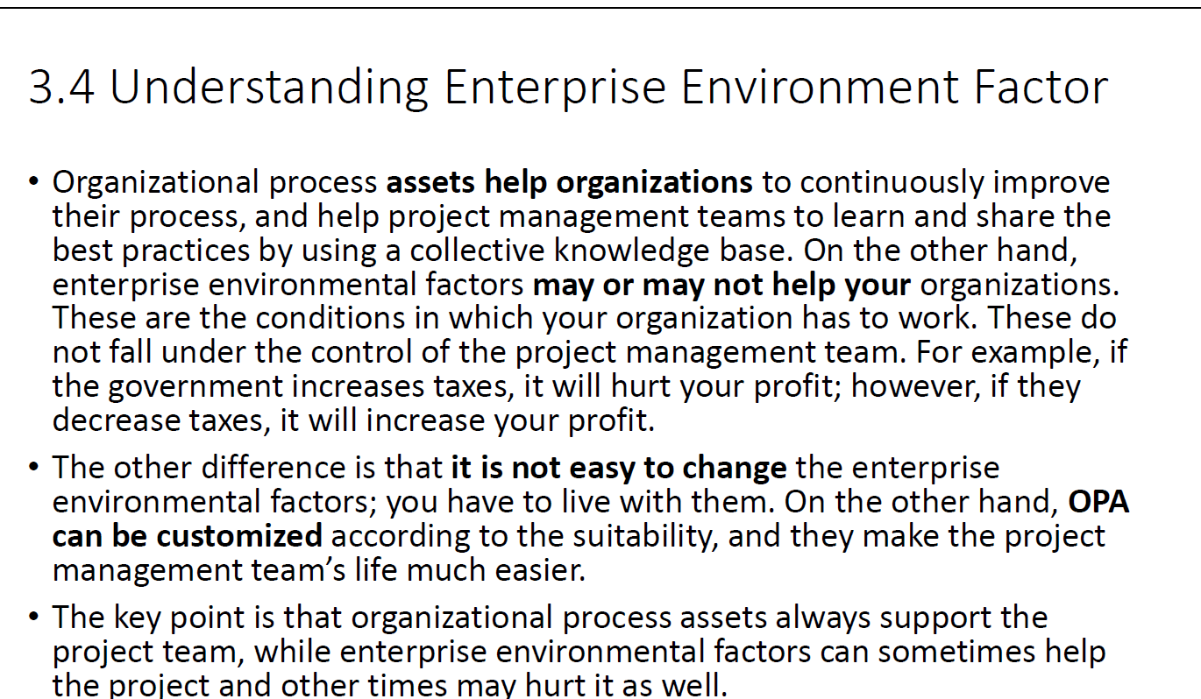

Slide 22
EEF
Enterprise Environmental Factors (EEFs) are external factors that can influence or impact a project, but they are generally beyond the control of the project team.
These factors provide the context in which a project operates and can significantly affect how the project is planned and executed.
Marketplace Conditions:
Example: The state of the economy, industry trends, and market demand for the product or service being delivered by the project.
Regulatory Environment:
Example: Government regulations, industry standards, and compliance requirements that the project must adhere to. For instance, projects in healthcare or finance may be subject to strict regulatory frameworks.
Stakeholder Tolerances and Thresholds:
Example: The acceptable levels of risk, schedule delays, and budget overruns as defined by key stakeholders. Understanding stakeholder expectations is crucial for project success.
Political Climate:
Example: Political stability or instability in the region where the organization operates can impact the project. Changes in government policies or leadership may affect the project's regulatory environment.

Slide 23
Marketplace Conditions:
Example: The level of competition in the marketplace, the availability of resources, and the overall economic conditions can influence project constraints and opportunities.
Technology Factors:
Example: The state of technology, the availability of specific tools or software, and the pace of technological change can impact project planning and execution.
Labor Market Conditions:
Example: The availability of skilled resources, labor market conditions, and potential shortages of specific skills needed for the project.
Financial Conditions:
Example: The financial health of the organization, including its budgetary constraints, cash flow, and availability of funding for the project.
Legal Considerations:
Example: Legal constraints, contracts, and agreements that the project must adhere to. This may include intellectual property laws, contract terms, and dispute resolution mechanisms.
Infrastructure:
Example: The availability and condition of physical infrastructure, such as transportation, communication, and facilities, which can impact project logistics.
Cultural Influences:
Example: Cultural factors that may impact the project, especially in international projects where cultural differences can affect communication, decision-making, and team dynamics.
Ethical Standards:
Example: The ethical guidelines and standards that the organization follows. Projects may need to align with the organization's ethical policies.

Slide 24
